Slide 1
Abstract Interpretation
ThanhVu Nguyen

Slide 2
Static Program Analysis
Discovering program properties statically
  The discovered properties are correct (for all possible execution path)
  Never had to execute the program
Asserting that some bad property will never occur
  E.g., dereferencing null pointer, division by zero, array out of bound, dead locking
  Allows compiler optimization, finding bugs
Incompleteness:
  Any interesting program property is undecidable (Rice’s Theorem)
  Precision vs. Complexity trade-off
  Have to settle for approximate but fast static analysis

Slide 3
Abstract Interpretation
A static analysis technique for program verification
  Prove program properties
    E.g., program is free of certain types of errors, div-by-0
  Popular in the industry
    Astree: verification tool applied to Airbus avionic systems
    Facebook Infer
Abstract Domains: approximate program properties
  Sign: x is either { -, 0, +}
  Odd/Even: x is either {odd, even}
  Interval Domain: x is in the range [min, max]
Invariant Inference
  Infer unknown invariant properties under various abstract domains
  Unlike program verification, for instance, program specifications are not required (in fact, we want to *discover* them)
    Thus input: program source (or object) code, output: facts about the program
  Somewhat in between type checking/inference and full program analysis
  Example:
    i = 4281 * 89731;
    array_a[i] or n/i
    If we are just interested in if i is - or i is 0 , then the real value of i is not needed. We just need to know the ‘sign’ of i
    Thus i is + , which is an approximation, but good enough to guarantee no problem with array boundary or with division by 0

Slide 4
Basic Structure of Abstract Interpretation
Deciding the Abstract Domain for the Concrete Domain of the variables
    Concrete value (x) = 6
    (Sign) Abstract value (x) = even
Defining Transfer functions for atomic statements/operations in the programming language
    6 / 2 = 3
    even / 2 = even, odd, 0
Making sure the analysis halts eventually
  Important: the program might not halt, but the static analysis on the program will !!

Slide 5
Abstract Domain
Abstract Function
α
Concrete Function
ϒ
Concrete Domain

Slide 6
Interval Domain (upperbound, lowerbound)
Abstract Domain
[Z, Z]
Concrete Domain
Z

Slide 7
Interval Domain
X = [1, 1]
α
ϒ
X = 1

Slide 8
Abstraction
X = [-5, 20]
α
X = 1
X = -5
X = 20

Slide 9
Concretization
X = [-5, 20]
ϒ
X = {-5,-4,…,19,20}
Notes:
Notice the approximation occurs here

Slide 10
Transfer Function: Assignment
X = [5, 5]
Y = [4, 4]
α
X = 5
Y = X - 1
Notes:
Assignments
Notice the limitation of interval domain, it abstract the fact that Y is X - 1

Slide 11
Transfer Function: Addition
[9,9] + [3,3] = [12,12]
α
9 + 3
Notes:
Assignments

Slide 12
Transfer Function: Addition
Assume x = [7,8], y = [3,12]
[7,8] + [3,12]= [10, 20]
α
x + y
Notes:
Operations
Here I only define the transfer function for addition, you can do something similar with whatever you have in your language such as division, multiplication, subsection, power , less than, factorial whatever …

Slide 13
Transfer Function: Union and Intersection
✪ if (x <= 4) then (✪ x = -10;✪) else (✪ x = 100;✪) ✪
  Find the abstract values of x at ✪✪✪✪✪ , assuming x is [0,7] at ✪

Slide 14
Transfer Function: Intersection
✪ if (x <= 4) then (✪ x = -10;✪) else (✪ x = 100;✪) ✪
  Assumption: x is [0,7] at ✪
At ✪, abstract val of x is the intersection of [0,7] with [-inf,4]. Why?

Slide 15
Transfer Function: Intersection
✪ if (x <= 4) then (✪ x = -10;✪) else (✪ x = 100;✪) ✪
  Assumption: x is [0,7] at ✪
At ✪, a is the intersection of [0,7] with [-inf,4]. Why?
Intersection
  [c1,c2] ^ [d1,d2] = [max(c1,d1), min(c2,d2)]
  Examples:
    [1,10] ^ [5,12] = [5,10]
    [3,7] ^ [1,9] = [3,7]
    [1,3] ^ [7,8] = [7,3] = []
    [0,7] ^ [-inf,4] = [0,4]

Slide 16
Transfer Function: Intersection
✪ if (x <= 4) then (✪ x = -10;✪) else (✪ x = 100;✪) ✪
  Assumption: x is [0,7] at ✪
At ✪, a is the intersection of [0,7] with [-inf,4]. Why?
Intersection
  [c1,c2] ^ [d1,d2] = [max(c1,d1), min(c2,d2)]
  Examples:
    [1,10] ^ [5,12] = [5,10]
    [3,7] ^ [1,9] = [3,7]
    [1,3] ^ [7,8] = [7,3] = []
    [0,7] ^ [-inf,4] = [0,4]
  Thus at ✪, x is [0,4]

Slide 17
Transfer Function: Intersection
✪ if (x <= 4) then (✪ x = -10;✪) else (✪ x = 100;✪) ✪
  Assumption: x is [0,7] at ✪
At ✪, a is the intersection of [0,7] with [-inf,4]. Why?
Intersection
  [c1,c2] ^ [d1,d2] = [max(c1,d1), min(c2,d2)]
  Examples:
    [1,10] ^ [5,12] = [5,10]
    [3,7] ^ [1,9] = [3,7]
    [1,3] ^ [7,8] = [7,3] = []
    [0,7] ^ [-inf,4] = [0,4]
  Thus at ✪, x is [0,7] ^ [-inf,4] = [0,4]
  And at ✪, x is [0,7] ^ [5, inf] = [5,7]

Slide 18
Transfer Function: Union
✪ if (x <= 4) then (✪ x = -10;✪) else (✪ x = 100;✪) ✪
At ✪, a is [0,4] and at ✪, x is [5,7]
At ✪ x is [-10,-10]
Notes:
We have seen Union already --- it’s so intuitive we just accepted it --- Remember these slides when I say
X = 1
X = -5
X = 10
And the abstract value for X is [-5, 10] --- how did I get this ? Basically union [1,1] with [-5,-5], [10,10]

Slide 19
Transfer Function: Union
✪ if (x <= 4) then (✪ x = -10;✪) else (✪ x = 100;✪) ✪
At ✪, a is [0,4] and at ✪, x is [5,7]
At ✪ x is [-10,-10]
At ✪ x is [100,100]
Thus
  at ✪, x is [-10,100] ([-10,4] U [5,100] merged branch results)
Union
  [c1,c2] U [d1,d2] = [min(c1,d1), max(c2,d2)]
  Examples:
    [10,4] U [-10,10] = [-10,10]
    [5,7] U [100,100] = [5,100]
    [-10,10] U [5,100] = [-10,100]
and [5,100], respectively.
Notes:
We have seen Union already --- it’s so intuitive we just accepted it --- Remember these slides when I say
X = 1
X = -5
X = 10
And the abstract value for X is [-5, 10] --- how did I get this ? Basically union [1,1] with [-5,-5], [10,10]

Slide 20
Looping: Widening Operator
  x = 7 ; while x < 1000 do (x = x + 1;) ✪
  Halting (e.g., termination of loop) is undecidable !!!
  Need to put a limit on the # of steps: after K number of iterations, do some approximation and stop the analysis of the loop
  Widening (Approximation) Operator
    [c1,c2] [d1,d2] = [c1 ≤ d1 ? c1 : -∞ , d2 ≤ c2 ? c2 : ∞)]
Notes:
Widening is where most approximation occurs

Slide 21
Looping: Widening Operator
  x = 7 ; while x < 1000 do (x = x + 1;) ✪
    Init: x = [7,7]
Notes:
Widening is where most approximation occurs

Slide 22
Looping: Widening Operator
  x = 7 ; while x < 1000 do (x = x + 1;) ✪
    Init: x = [7,7]
    Intersect with guard [7,7] ^ [-inf,1000] = [7,7]
      Iter 1: x is [8,8] then union with [7,7] , we have [7,8]
Notes:
Widening is where most approximation occurs

Slide 23
Looping: Widening Operator
  x = 7 ; while x < 1000 do (x = x + 1;) ✪
    Init: x = [7,7]
    Intersect with guard [7,7] ^ [-inf,1000] = [7,7]
      Iter 1: x is [8,8] then union with [7,7] , we have [7,8]
    Intersect with guard [7,8] ^ [-inf,1000] = [7,8]
      Iter 2: x is [9,9] then union with [7,8] , we have [7,9]
Notes:
Widening is where most approximation occurs

Slide 24
Looping: Widening Operator
  x = 7 ; while x < 1000 do (x = x + 1;) ✪
    Init: x = [7,7]
    Intersect with guard [7,7] ^ [-inf,1000] = [7,7]
      Iter 1: x is [8,8] then union with [7,7] , we have [7,8]
    Intersect with guard [7,8] ^ [-inf,1000] = [7,8]
      Iter 2: x is [9,9] then union with [7,8] , we have [7,9]
    Intersect with guard [7,9] ^ [-inf,1000] = [7,9]
      Iter 3: x is [10,10] then union with [7,9] , we have [7,10]
Notes:
Widening is where most approximation occurs

Slide 25
Looping: Widening Operator
  x = 7 ; while x < 1000 do (x = x + 1;) ✪
    Init: x = [7,7]
    Intersect with guard [7,7] ^ [-inf,1000] = [7,7]
      Iter 1: x is [8,8] then union with [7,7] , we have [7,8]
    Intersect with guard [7,8] ^ [-inf,1000] = [7,8]
      Iter 2: x is [9,9] then union with [7,8] , we have [7,9]
    Intersect with guard [7,9] ^ [-inf,1000] = [7,9]
      Iter 3: x is [10,10] then union with [7,9] , we have [7,10]
    Intersect with guard [7,10] ^ [-inf,1000] = [7,10]
      Iter 4: x is [11,11] then widening with [7,8], i.e., [7,8] [11,11] , we have [7, ∞]
      Widening is where most approximation occurs
  Widening (Approximation) Operator
    [c1,c2] [d1,d2] = [c1 ≤ d1 ? c1 : -∞, d2 ≤ c2 ? c2 : ∞)]
Notes:
Widening is where most approximation occurs

Slide 26
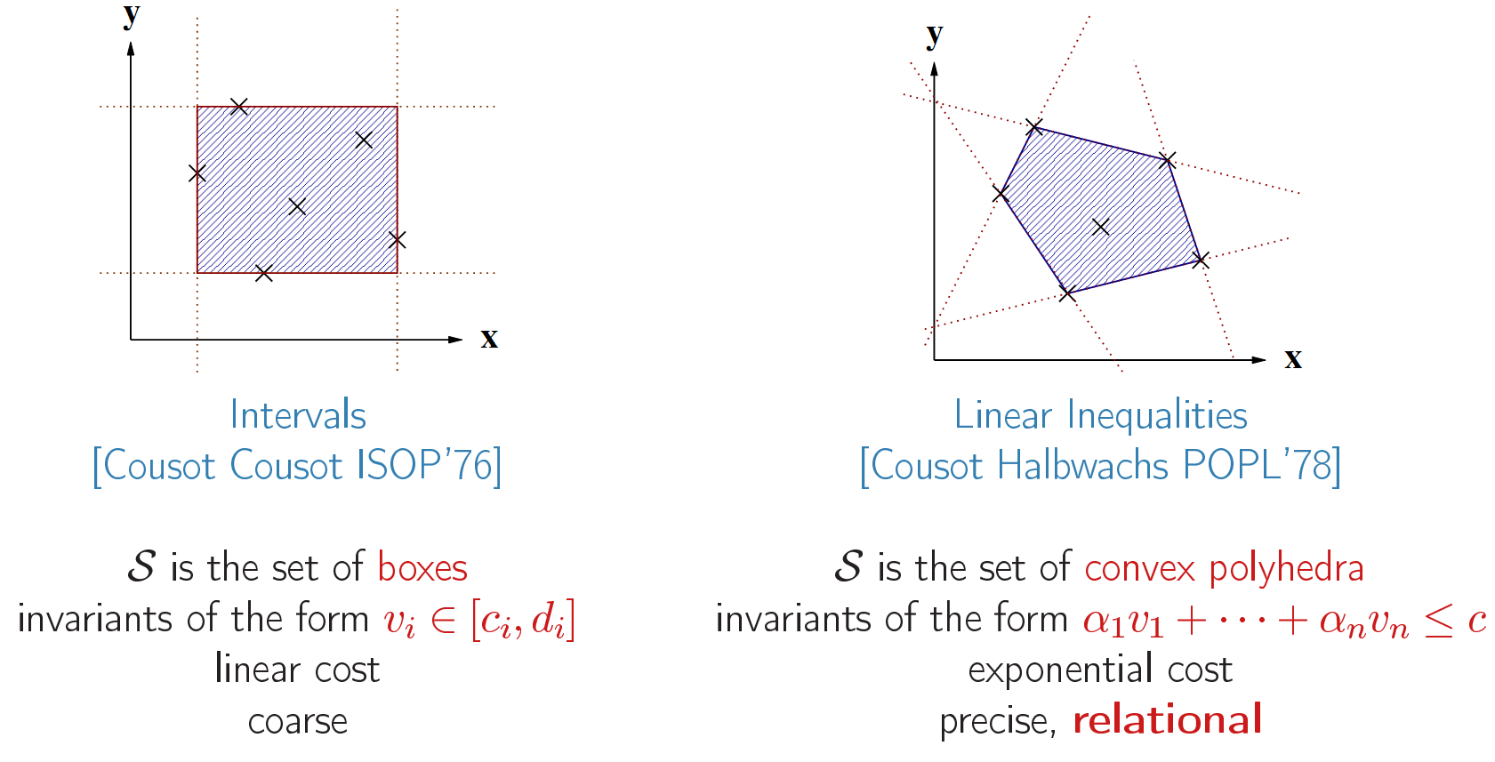

Slide 27
Topic Reviews: Testing
Basic Fuzzing, i.e., random input generation
  Goal: Code Coverage
  From scratch, from some existing, valid inputs, from grammar
Search-based Testing
  Goal: gradually evolve a solution
  Genetic Algorithm, Chromosome Representation, Fitness Evaluation, Mutation, Crossover, Stopping Criteria
Mutation Testing
  Goal: to evaluate a test suite
  Generate mutants
Delta Debugging
  Goal: to reduce/simplify an input
  Binary search like approach

Slide 28
Topic Reviews: Testing
Statistical Debugging
  Goal: fault localization
  Positive/Negative tests, assign suspicious score
Information Flow
  Goal: check if important information is leaked
  Tainted Information
Symbolic Execution
  Goal: employ constraint solving to generate difficult
  Represent inputs as symbolic values, fork into multiple branches when hitting condition statements
Dynamic Invariants Inference
  Goal: discovering unknown properties from program runs
  Generate invariants in various domains, e.g., relations among variables, from execution traces. Unsound

Slide 29
Topic Reviews: Verification
The While Language
  Goal: a simple language so that we can formally define semantics
  Turing Complete: Assignment, Condition, Loop
Denotational Semantics
  Goal: reason about the semantics of the program
  Big Step semantics: evaluate semantics or effects of each program statement over program states
Axiomatic Semantics
  Goal: reason and prove program correctness
  Hoare Triple, loop invariants
Abstract Interpretation
  Goal: approximating program behaviors
  Abstract domains: sign, even/odd, interval, transfer functions

Slide 30
Topic Reviews: Miscs
Constraint Solver
  Goal: determine if a formula is satisfiable or not
  Used in symbolic execution and many verification approaches
Intro to Boolean / First Order logic
  Goal: reason about the semantics of the program
  Big Step semantics: evaluate semantics or effects of each program statement over program states
Soundness / Completeness
  Testing vs Verification
  Decidability

Slide 31
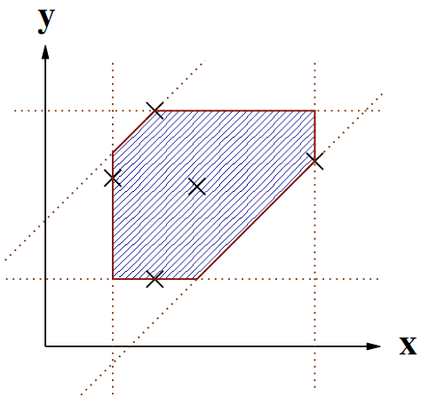
Zone domain
Interval domain (a <= v <= b) is fast but imprecise (no relations between variables)
Zone domain: v_i – v_j <= c and +- v_i <= c

Slide 32
Zone Domain
v_j – v_i <= c
α
ϒ
R (or Z or Q)

Slide 33
Zone Domain
x – 0 <= 10
0 – x <= -10
α
x = 10

Slide 34
Zone Domain
x – 0 <= 10
0 – x <= -10
Let v_1 = 0
α
x = 10

Slide 35
Zone Domain
x – v_1 <= 10
v_1 – x <= -10
Let v_1 = 0
α
x = 10

Slide 36
Zone Domain
x – v_1 <= 10
v_1 – x <= -10
ϒ
{x| x – 0 <= 10 & 0 –x <= -10}
Notes:
In this case, only 1 point , that is {x=10}

Slide 37
Zone Domain
x – v_1 <= 10
v_1 – x <= -10
y – v_1 <= 7
v_1 – y <= -7
x – y <= 3
y – x <= -3
α
X = 10
Y = 7

Slide 38
Zone Domain
x – v_1 <= 10
v_1 – y <= -10
y – v_1 <= 7
V_1 – y <= -7
x – y <= 3
y – x <= -3
ϒ
{(x,y) | (x,y) satisfies all constraints above)
Notes:
In this case, {(x=10,y=5)} only 1 point
Ok from now on I will just write x <= c which represents x – v1 <= c and -x <= c for v1 <= c

Slide 39
Zone Domain
v_2 <= 4
-v2 <= -1
v3 <= 3
-v3 <= -1
v2 – v3 = 1
ϒ
Notes:
This abstract domain is now a region ! A set of many points

Slide 40
Set of Constraints, Matrix, and Graph
Constraints v_j – v_i <= c
Diff Bound Matrix M (|v| x |v|):
  M(i,j) = c (when v_j – vi <= c) else inf
Graph G=(V,E,w)
  W(E(i,j)) = c when v_j – v_i <= c or M(i,j) = c

Slide 41
Set of Constraints, Matrix, and Graph
Constraint
v_{j} – v_{i} <= c
Matrix
Graph
C
 |  |  | V_{i}
v_{i} |  |  | c
v_{i}
v_{j}

Slide 43
Problem
When x is equivalent to y in the Concrete Domain, then we expect the x^{α} is equivalent to y^{α} in the Abstract Domain
Not so in this Zone Abstract domain !!

Slide 44
v_2 <= 4
-v2 <= -1
v3 <= 3
-v3 <= -1
v2 – v3 = 1
ϒ

Slide 45
v_2 <= 4
-v2 <= -1
v3 <= 3
-v3 <= -1
v2 – v3 = 1
v_2 <= 5
-v2 <= -1
v3 <= 3
-v3 <= -1
v2 – v3 = 1
ϒ
ϒ

Slide 46
Two different sets of constraints (the lines) still describe the same region (shaded).
However, the figure on the right with the constraint represented by the red line is not very tight !

Slide 47
Normalization (Closure)
To have x = y implies x^{α} = y^{α}
  That is, if the concrete domains (the region of points) of x and y are the same, then their abstract versions (the sets of constraints or matrices or graphs) should also be the same.
How to achieve this: tighten the boundaries as much as possible !!

Slide 48
Normalization (Closure)
To have x = y implies x^{α} = y^{α}
  That is, if the concrete domains (the region of points) of x and y are the same, then their abstract versions (the sets of constraints or matrices or graphs) should also be the same.
How to achieve this: tighten the boundaries as much as possible !!

Slide 49
Normalization (Closure)
Objective: having x = y implies x^{α} = y^{α}
  That is, if the concrete domains (the region of points) of x and y are the same, then their abstract versions (the sets of constraints or matrices or graphs) should also be the same.
Solution: tighten the boundaries as much as possible !!
Compute the shortest path (Bellman Ford with negative cycle detection)
  This method was suggested by the author of the Zone domain
  Runs in cubic time (of the number of vertices or variables)
  Giving a graph G=(V,E,w) , the method yields a new graph G=(V,E,w’) such that w’ is the smallest distance between any pair of vertices
    Why negative cycle is bad ?

Slide 51
Not yet done from here on – will continue later today

Slide 52
Transfer Functions
Assignment
  x = 10 ; y = 5
Binary Operations
  x = x - 2
Matrix | 0 | x | y
0 | 0 | 10 | 5
x | -10 | 0 | -5
y | -5 | 5 | 0
Matrix | 0 | x | y
0 | 0 | 8 | 5
x | -8 | 0 | -3
y | -5 | 3 | 0

Slide 53
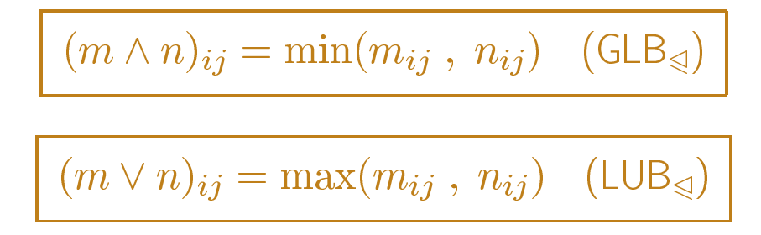
Union and Intersection
Notes:
Exactly like Interval domain, e.g., if we incrase x by 1 , then range increase by 1 , here the bound increase by 1

Slide 54
Transfer Functions: Intersection
m* | 0 | x | y
0 | 0 | -8 | -5
x | 8 | 0 | 3
y | 5 | -3 | 0
n* | 0 | x | y
0 | 0 | -10 | -5
x | 10 | 0 | 5
y | 5 | -5 | 0
Notes:
Tighter bound
Closed under *

Slide 55
Transfer Functions: Intersection
m* | 0 | x | y
0 | 0 | -8 | -5
x | 8 | 0 | 3
y | 5 | -3 | 0
When we intersect two matrices ?
Intersection is used, for example, when dealing with guards
✪ If (x – y <= c) {✪… }
  The matrix at ✪ is the intersection of the matrix at ✪ and the matrix representing the constraint x –y <= c
n* | 0 | x | y
0 | 0 | -10 | -5
x | 10 | 0 | 5
y | 5 | -5 | 0
m*^n* | 0 | x | y
0 | 0 | -10 | -5
x | 8 | 0 | 3
y | 5 | -5 | 0
Notes:
Tighter bound
Closed under *

Slide 56
Transfer Functions: Union
 | 0 | x | y
0 | 0 | -8 | -5
x | 8 | 0 | 3
y | 5 | -3 | 0
When we union two matrices ?
Union is used, for example, when merging branches
If (cond1) then (… ✪) elif (cond2) then (…. ✪) else (… ✪) ✪
  The matrix at ✪ is the union of the matrix at ✪ ✪ ✪
 | 0 | x | y
0 | 0 | -10 | -5
x | 10 | 0 | 5
y | 5 | -5 | 0
 | 0 | X | y
0 | 0 | -8 | -5
x | 10 | 0 | 5
y | 5 | -3 | 0
Notes:
Looser bound
Not necessarily Closed under *

Slide 57
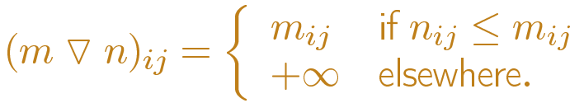
Widening
 | 0 | X | y
0 | 0 | -8 | -5
x | 10 | 0 | 5
y | 5 | -3 | 0
 | 0 | x | y
0 | 0 | -9 | -4
x | 8 | 0 | 7
y | 5 | -5 | 0
For loop termination, we use widening
After certain loop iteration i, we apply the widening operation to the matrices before and after the loop iteration i
 | 0 | x | y
0 | 0 | -8 | ∞
x | 10 | 0 | ∞
y | 5 | -3 | 0
Notes:
Looser bound
Not necessarily Closed under *

Slide 58
Summary
Abstract Interpretation: Static Analysis framework for automatic program properties discovery
Approximated: designed a specific form of invariants to find (e.g., the abstract domain: Interval or Zone)
Soundness: reported properties are always correct
  Never have to run program through any input, don’t need to give any specification or invariants etc
  Input: source code (or object code) => Output: facts about the program
Termination: To achieve termination (e.g., in loop), widening is used.

Slide 59
The entire framework is based on solid mathematics (not presented here)
  Lattice theory, fixed point semantics in loop, glb/lub for intersection/union
Practical: Used in mission critical software
  The ASTREE software, employing several Abstract Interpretation domains (e.g., the Ellipsoid, Octagon domain), is responsible for verifying that the avionic control system of Airbus is free of run-time error.
Notes:
208 Mec -- 3:30

Slide 60
The End

Slide 61
Transfer Function: If-then-else
How to deal with something longer ?
  if (a < 8) then (c = a + 2) else (c = a + a; d = a + 4;)
Break it into smaller operation and recursively apply the corresponding abstract function α
  (if (a < 8) then (c = a + 2) else (c = a + a; d = a + 4;))^{α}
  if (a < 8) ^{α} then (c = a + 2) ^{α} else (c = a + a; d = a + 4;)^{α}
  if (a^{α} <^{α} 8^{α}) then (c^{α} =^{α} a^{α} +^{α} 2^{α}) else (c^{α} =^{α} a^{α} +^{α} a^{α}; d^{α} =^{α} a^{α} + 4^{α};)
  ….

